Slide 1

Connect 4
presentation

Slide 2
Reason of choosing this problem :
Because we are interesting to making computer game

Slide 3
Problem Analysis:
1-make the Board of Game
2-playing disc
3-putting playing disc on the board
4-check if the place is empty or not
5-check if one’s of players win or not
6-modes of playing
7-in pc mode check if put the disc in full column
8-if one win ask if he wants to play again or not

Slide 4
Making the Board of Game

Slide 5
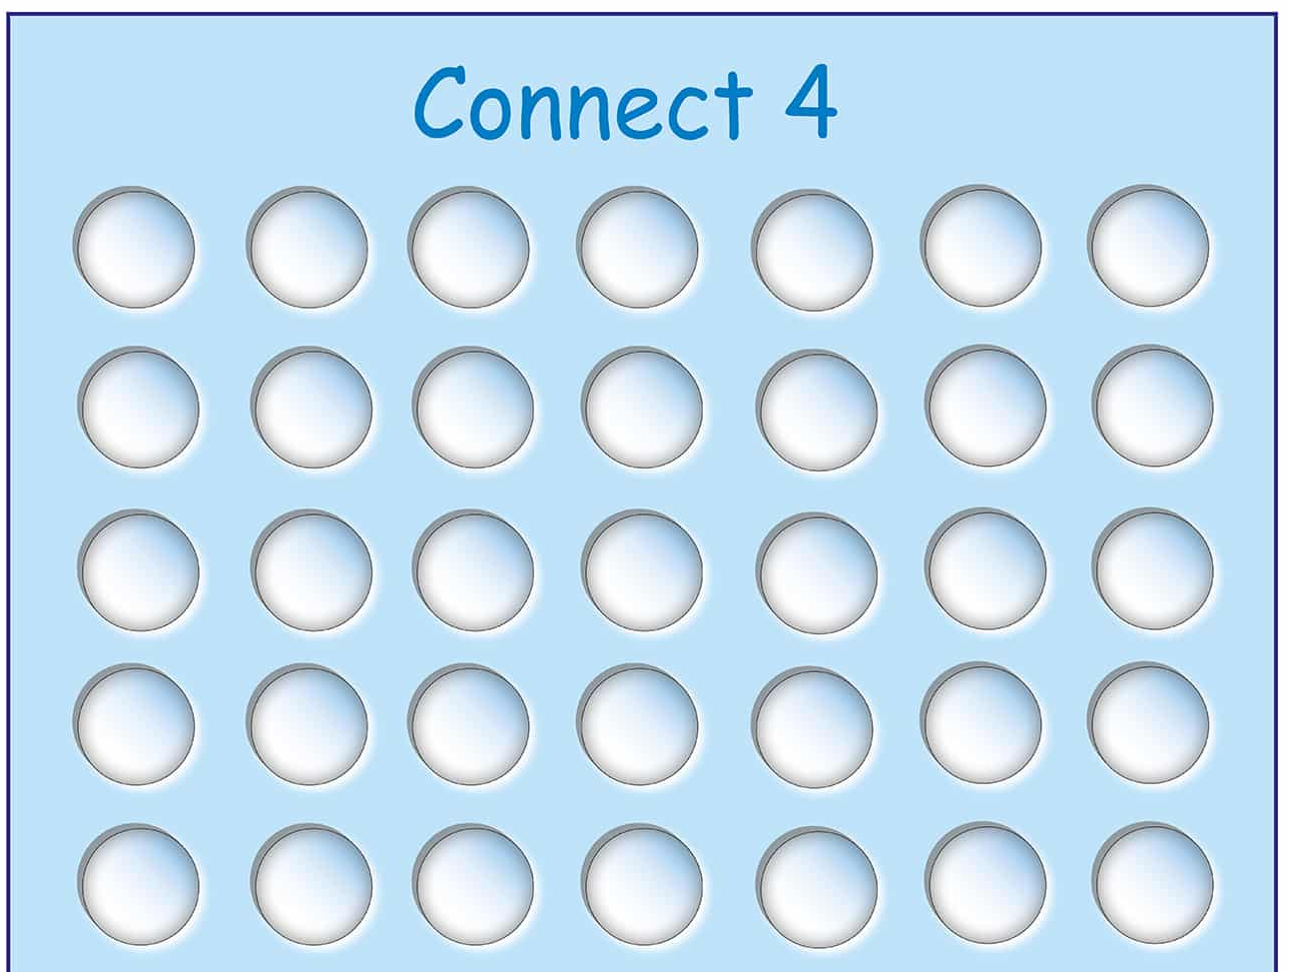
| 0 | 1 | 2 | 3 | 4 | 5 | 6 |
------------------------------------------------------------------
| | | | | | | |
------------------------------------------------------------------
| | | | | | | |
------------------------------------------------------------------
| | | | | | | |
------------------------------------------------------------------
| | | | | | | |
------------------------------------------------------------------
| | | | | | | |
------------------------------------------------------------------

Slide 6

Code

Slide 7
#include<iostream>
using namespace std;
char x[5][7]={{' ',' ',' ',' ',' ',' ',' '},
{' ',' ',' ',' ',' ',' ',' '},
{' ',' ',' ',' ',' ',' ',' '},
{' ',' ',' ',' ',' ',' ',' '},
{' ',' ',' ',' ',' ',' ',' '}};
void board()
{
cout<<"| "<<0<<" ";cout<<"| "<<1<<" "; cout<<"| "<<2<<" ";cout<<"| "<<3<<" ";
cout<<"| "<<4<<" ";cout<<"| "<<5<<" "; cout<<"| "<<6<<" "<<"|\n";
// first row
cout<<"-----------------------------------------------------------------------\n";
cout<<"| "<<x[0][0]<<" ";cout<<"| "<<x[0][1]<<" "; cout<<"| "<<x[0][2]<<" ";cout<<"| "<<x[0][3]<<" ";
cout<<"| "<<x[0][4]<<" ";cout<<"| "<<x[0][5]<<" "; cout<<"| "<<x[0][6]<<" "<<"|\n";
cout<<"-----------------------------------------------------------------------\n";
//second row
cout<<"| "<<x[1][0]<<" ";cout<<"| "<<x[1][1]<<" "; cout<<"| "<<x[1][2]<<" ";cout<<"| "<<x[1][3]<<" ";
cout<<"| "<<x[1][4]<<" ";cout<<"| "<<x[1][5]<<" "; cout<<"| "<<x[1][6]<<" "<<"|\n";
cout<<"-----------------------------------------------------------------------\n";
//third row
cout<<"| "<<x[2][0]<<" ";cout<<"| "<<x[2][1]<<" "; cout<<"| "<<x[2][2]<<" ";cout<<"| "<<x[2][3]<<" ";
cout<<"| "<<x[2][4]<<" ";cout<<"| "<<x[2][5]<<" "; cout<<"| "<<x[2][6]<<" "<<"|\n";
cout<<"-----------------------------------------------------------------------\n";
//fourth row
cout<<"| "<<x[3][0]<<" ";cout<<"| "<<x[3][1]<<" "; cout<<"| "<<x[3][2]<<" ";cout<<"| "<<x[3][3]<<" ";
cout<<"| "<<x[3][4]<<" ";cout<<"| "<<x[3][5]<<" ";bcout<<"| "<<x[3][6]<<" "<<"|\n";
cout<<"-----------------------------------------------------------------------\n";
//fifth row
cout<<"| "<<x[4][0]<<" ";cout<<"| "<<x[4][1]<<" "; cout<<"| "<<x[4][2]<<" ";cout<<"| "<<x[4][3]<<" ";
cout<<"| "<<x[4][4]<<" ";cout<<"| "<<x[4][5]<<" "; cout<<"| "<<x[4][6]<<" "<<"|\n";
cout<<"-----------------------------------------------------------------------\n";
}
Global variable 2D array

Slide 8
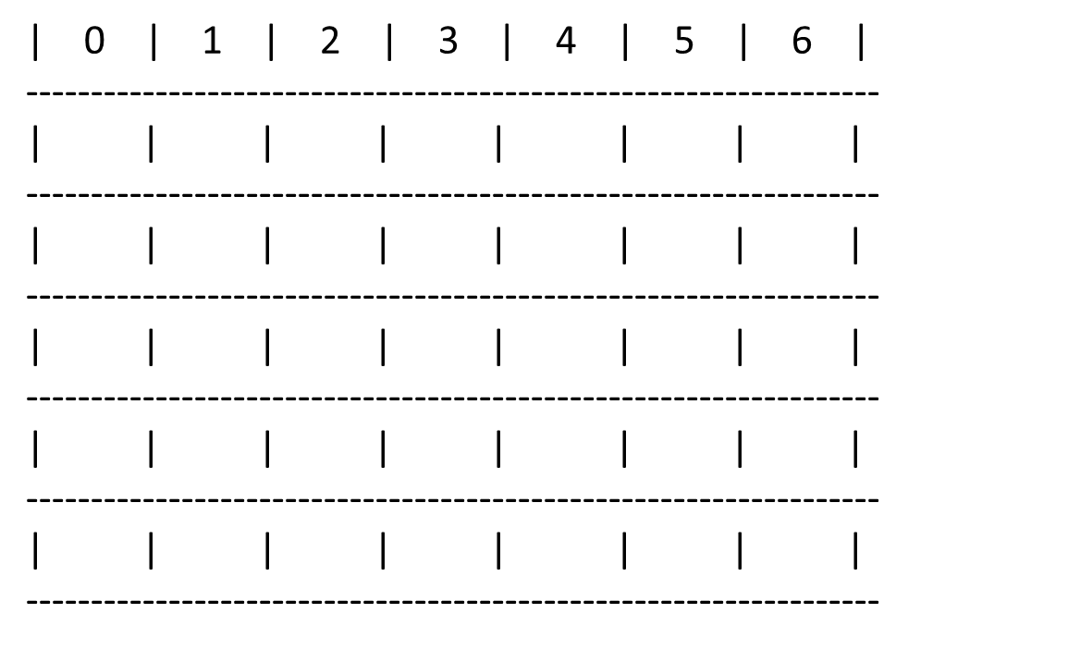
void board()
{
cout<<"| "<<0<<" ";cout<<"| "<<1<<" "; cout<<"| "<<2<<" ";cout<<"| "<<3<<" ";
cout<<"| "<<4<<" ";cout<<"| "<<5<<" "; cout<<"| "<<6<<" "<<"|\n";
// first row
cout<<"-----------------------------------------------------------------------\n";
cout<<"| "<<x[0][0]<<" ";cout<<"| "<<x[0][1]<<" "; cout<<"| "<<x[0][2]<<" ";cout<<"| "<<x[0][3]<<" ";
cout<<"| "<<x[0][4]<<" ";cout<<"| "<<x[0][5]<<" "; cout<<"| "<<x[0][6]<<" "<<"|\n";
cout<<"-----------------------------------------------------------------------\n";
//second row
cout<<"| "<<x[1][0]<<" ";cout<<"| "<<x[1][1]<<" "; cout<<"| "<<x[1][2]<<" ";cout<<"| "<<x[1][3]<<" ";
cout<<"| "<<x[1][4]<<" ";cout<<"| "<<x[1][5]<<" "; cout<<"| "<<x[1][6]<<" "<<"|\n";
cout<<"-----------------------------------------------------------------------\n";
//third row
cout<<"| "<<x[2][0]<<" ";cout<<"| "<<x[2][1]<<" "; cout<<"| "<<x[2][2]<<" ";cout<<"| "<<x[2][3]<<" ";
cout<<"| "<<x[2][4]<<" ";cout<<"| "<<x[2][5]<<" "; cout<<"| "<<x[2][6]<<" "<<"|\n";
cout<<"-----------------------------------------------------------------------\n";
//fourth row
cout<<"| "<<x[3][0]<<" ";cout<<"| "<<x[3][1]<<" "; cout<<"| "<<x[3][2]<<" ";cout<<"| "<<x[3][3]<<" ";
cout<<"| "<<x[3][4]<<" ";cout<<"| "<<x[3][5]<<" ";bcout<<"| "<<x[3][6]<<" "<<"|\n";
cout<<"-----------------------------------------------------------------------\n";
//fifth row
cout<<"| "<<x[4][0]<<" ";cout<<"| "<<x[4][1]<<" "; cout<<"| "<<x[4][2]<<" ";cout<<"| "<<x[4][3]<<" ";
cout<<"| "<<x[4][4]<<" ";cout<<"| "<<x[4][5]<<" "; cout<<"| "<<x[4][6]<<" "<<"|\n";
cout<<"-----------------------------------------------------------------------\n";
}
char x[5][7]={{' ',' ',' ',' ',' ',' ',' '},
{' ',' ',' ',' ',' ',' ',' '},
{' ',' ',' ',' ',' ',' ',' '},
{' ',' ',' ',' ',' ',' ',' '},
{' ',' ',' ',' ',' ',' ',' '}};

Slide 9
New code:
void print()
{
printf(" ");
for (int c=0;c<7;c++)
{
printf(" %d ",c);
}
printf("\n");
for (int r=0;r<6;r++) {
for (int c=0;c<7;c++) {
printf(" [%c] ",board[r][c]);
}
printf("\n");
}
}

Slide 10
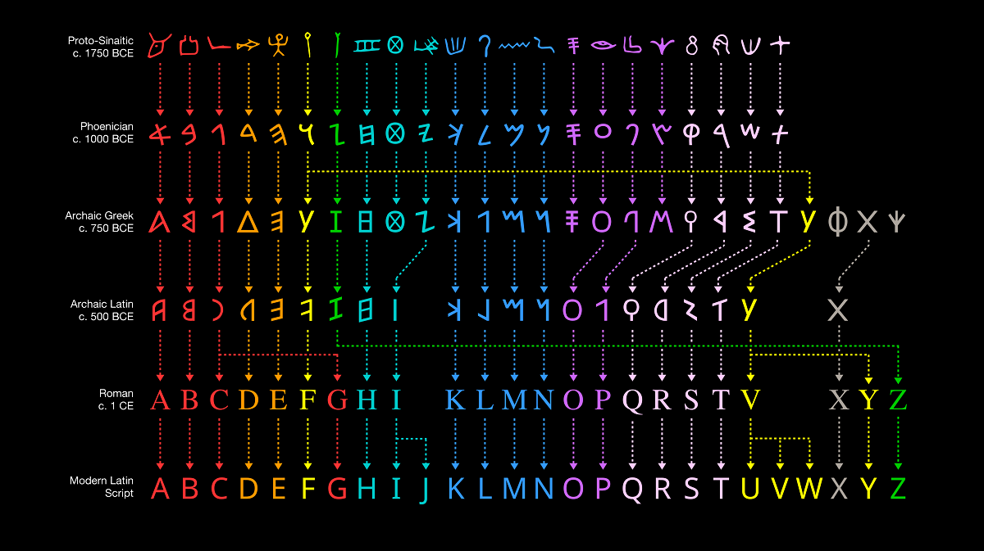
Playing disc

Slide 11
We suppose that playing discs are

Slide 12

Putting playing disc on the board
&
Check if the place is empty or not

Slide 13
Code

Slide 14
int insert(char c,int x)
{
if((x<0)||(x>6))
{
return 3;
}
else if(arr[x]!=6)
{
board[5-arr[x]][x]=c;
arr[x]++;
return 1;
}
return 0;
}
Here we used linear search algorithm
to find empty place to put the symbol of player

Slide 15


Check if one’s of players
Win or Not

Slide 16
Code

Slide 17
int win(char p ,int n )
{
//p symbol of player , n nunber of player
// search in row
for (int i = 0; i < 5 ; ++i)
{
for (int j = 0; j <=3 ; ++j)
{
if (x[i][j]==p && x[i][j+1]==p && x[i][j+2]==p && x[i][j+3]==p)
{
printf("player "<<n <<" is win\n“);
return 1;
}
}
}
// search in column
for (int i = 0; i < 7 ; ++i)
{
for (int j = 0; j <=1 ; ++j)
{
if (x[j][i]==p && x[j+1][i]==p && x[j+2][i]==p && x[j+3][i]==p)
{
printf ("player "<<n <<" is win\n“);
return 1;
}
}
}
//search in diagonal
for (int i = 4; i >=3 ; --i)
{
for (int j = 0; j <=3 ; ++j)
{
if (x[i][j]==p && x[i-1][j+1]==p && x[i- 2][j+2]==p && x[i-3][j+3]==p)
{
printf ("player "<<n <<" is win\n“);
return 1;
}
}
}
return 0;
}

Slide 18
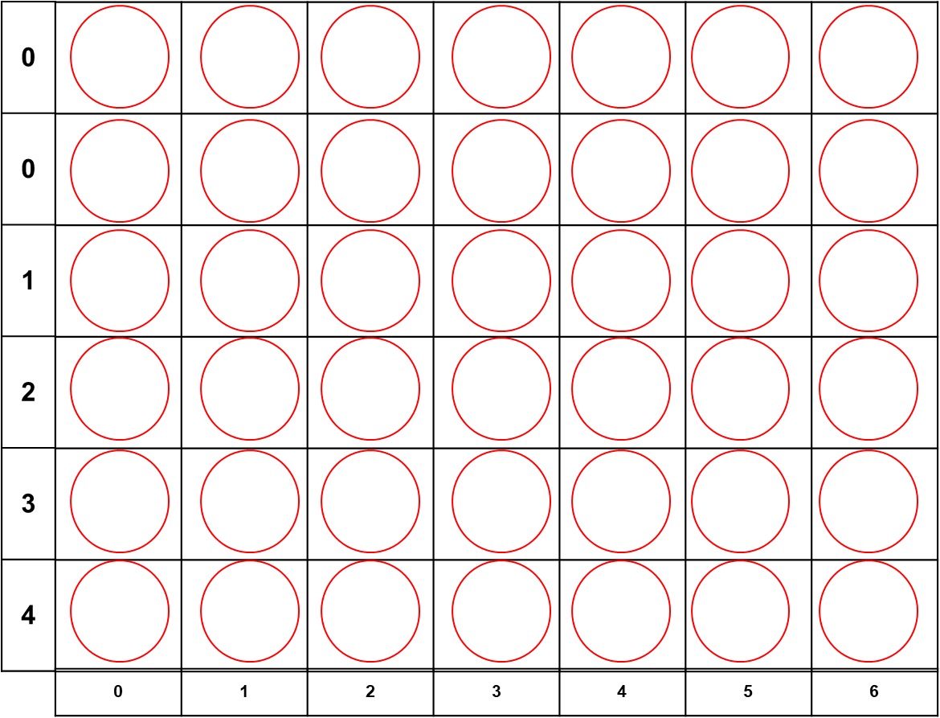
// search in row
for (int i = 0; i < 5 ; ++i)
{
for (int j = 0; j <=3 ; ++j)
{
if (x[i][j]==p && x[i][j+1]==p && x[i][j+2]==p && x[i][j+3]==p)
{
printf("player "<<n <<" is win\n“);
return 1;
}
}
}
First loop: Row (0)
col(0 1 2 3),col(1 2 3 4),col(2 3 4 5),col(3 4 5 6)
second loop: Row (1)
col(0 1 2 3),col(1 2 3 4),col(2 3 4 5),col(3 4 5 6)
Third loop: Row (2)
col(0 1 2 3),col(1 2 3 4),col(2 3 4 5),col(3 4 5 6)
fourth loop: Row (3)
col(0 1 2 3),col(1 2 3 4),col(2 3 4 5),col(3 4 5 6)
x
x
x
x

Slide 19
// search in column
for (int i = 0; i < 7 ; ++i)
{
for (int j = 0; j <=1 ; ++j)
{
if (x[j][i]==p && x[j+1][i]==p && x[j+2][i]==p && x[j+3][i]==p)
{
printf("player "<<n <<" is win\n“);
return 1;
}
}
}
x
x
First loop: col(0)
row(0 1 2 3 ),row(1 2 3 4)
second loop: col(1)
row(0 1 2 3 ),row(1 2 3 4)
x
third loop: col(2)
row(0 1 2 3 ),row(1 2 3 4)
x
fourth loop: col(3)
row(0 1 2 3 ),row(1 2 3 4)

Slide 20
//search in diagonal
for (int i = 4; i >=3 ; --i)
{
for (int j = 0; j <=3 ; ++j)
{
if (x[i][j]==p && x[i-1][j+1]==p && x[i-2][j+2]==p && x[i-3][j+3]==p)
{
printf("player "<<n <<" is win\n“);
return 1;
}
}
}
x
x
x
Row | Col
4 | 0
3 | 1
2 | 2
1 | 3
Row | Col
i | J
i-1 | J+1
i-2 | J+2
i-3 | J+3
x
x
x
x
x

Slide 21
//search in diagonal
for (int i = 4; i >=3 ; --i)
{
for (int j = 0; j <=3 ; ++j)
{
if (x[i][j]==p && x[i+1][j+1]==p && x[i+2][j+2]==p && x[i+3][j+3]==p)
{
printf("player "<<n <<" is win\n“);
return 1;
}
}
}
x
x
x
Row | Col
0 | 0
1 | 1
2 | 2
3 | 3
Row | Col
i | J
i+1 | J+1
i+2 | J+2
i+3 | J+3
x
x
x
x
x

Slide 22

MOD

Slide 23
There are 2 mods:
First
Player vs pc
second
Player vs Player

Slide 24
Menu
void startgame()
{
//board initializaton
for (int i = 0; i < 6; ++i)
{
for (int j = 0; j < 7; ++j)
{
board[i][j]=' ';
arr[j]=0;
}
}
srand(time(0));
int turn=(rand()%2);
printf("choose the mode:\n1- 1 VS 1\n2- 1 VS AI\n");
int mode,difficulty;
//user chooses the mode
scanf("%d",&mode);
//user chooses the difficulty
if (mode==2)
{
difficulty=diff();
}
printf("each player must choose a column form 0 to 6\n");
print();

Slide 25


Slide 26
Code

Slide 27
//user input
while (checkboard()!=3)
{
//player1 turn
if(turn==0)
{
printf("player1 : ");
player(player1piece);
//check win
print();
if(checkboard()==1)
{
printf("player1 wins\n");
return;
}
turn=1;
}
else if(turn==1)
{
//player2 turn
if (mode==1)
{
printf("player2 : ");
player(AI_player2piece);
//check win
print();
if(checkboard()==2)
{
printf("player2 wins\n");
return;
}
}
}

Slide 28


Slide 29
To make pc playing , we must make the pc choose random number from 0 to 6 and change every time
So, we need to include stdlib.h and time.h
#include <stdlib.h>
From this library we used
rand() → to make the number random but to make the range form 0 to 6 → rand()%7
But we must make the set change every time to generate different number so, we used
srand() → to make the random number change
But we must put inside the srand() number change always so, we used
time() form #include <time.h> since it change every second
So, it becomes → srand(time(0))

Slide 30
int mode1()
{
int choose,w;
board();
do {
p1:
printf ( "Player 1 choose no form 0 to 6\n“);
scanf(“%d”, &choose);
if (choose >= 0 && choose <= 6)
{
put(choose, 'x');
board();
w = win('x', 1);
if (w) { return 1; };
} else { wrong(); goto p1; }
pc:
srand(time(0));
choose = rand() % 7;
int v = check(choose);
if (v) goto pc;
put(choose, 'o');
board();
w = win('o', 2);
if (w) { return 1; };
}while(1);
}

Slide 31
Code

Slide 32
//AI turn
else
{
printf("AI:\n");
int result= minimax(difficulty,1,1);
print();
if(checkboard()==2)
{
printf("AI wins\n");
return;
}
}
turn=0;
}
}
printf("DRAW\n");

Slide 33

Check if put the disc in full column

Slide 34
Code

Slide 35
By using one dimension array which increase 1 by adding a value in column
arr[7]={ 0 , 0 , 0 , 0 , 0 , 0 , 0 }

Slide 36



Slide 37
Code

Slide 38
int main()
{
char again;
do
{
startgame();
printf("Play again[Y/N]:");
scanf(" %c",&again);
}while (again=='y'||again=='Y');
return 0;
}

Slide 39

ALGORITHM

Slide 40
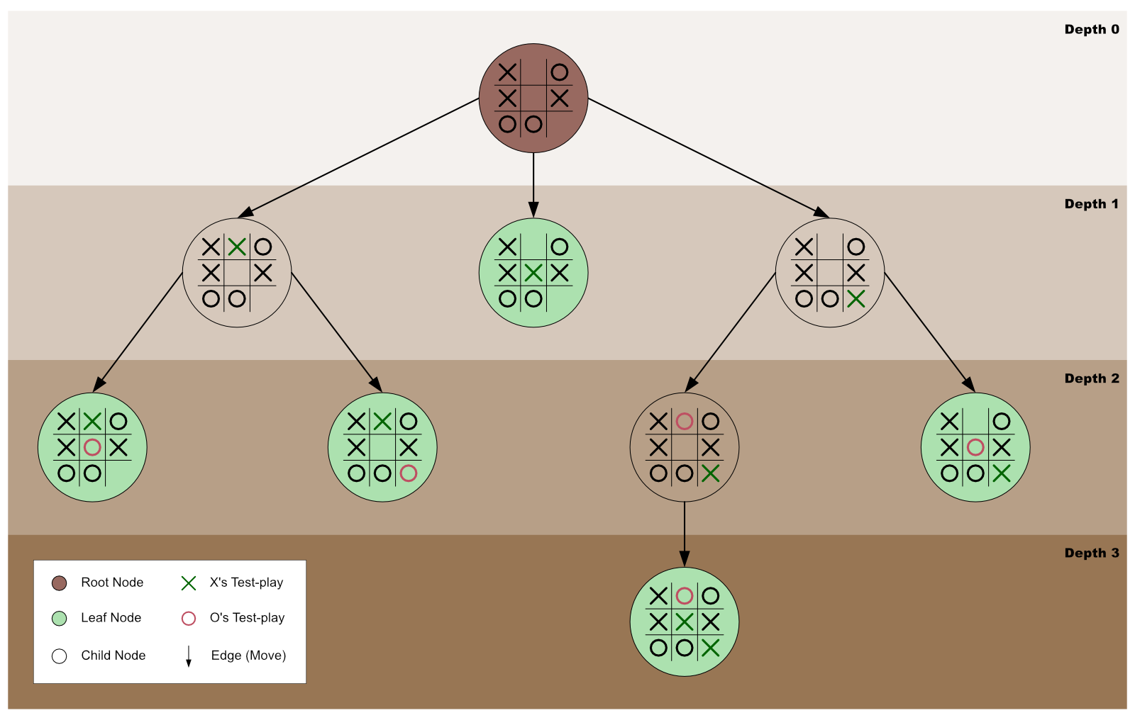
Minimax algorithm:
-A minimax algorithm is a recursive program written to find the best gameplay that minimizes any tendency to lose a game while maximizing any opportunity to win the game.
-Graphically, we can represent minimax as an exploration of a game tree's nodes to discover the best game move to make.

Slide 41
Implementation:
function minimax(node, depth, maximizingPlayer) is
if depth = 0 or node is a terminal node then
return the heuristic value of node
if maximizingPlayer then
value := −∞
for each child of node do
value := max(value, minimax(child, depth − 1, FALSE))
return value
else (* minimizing player *)
value := +∞
for each child of node do
value := min(value, minimax(child, depth − 1, TRUE))
return value

Slide 42


